Slide 1


Slide 2
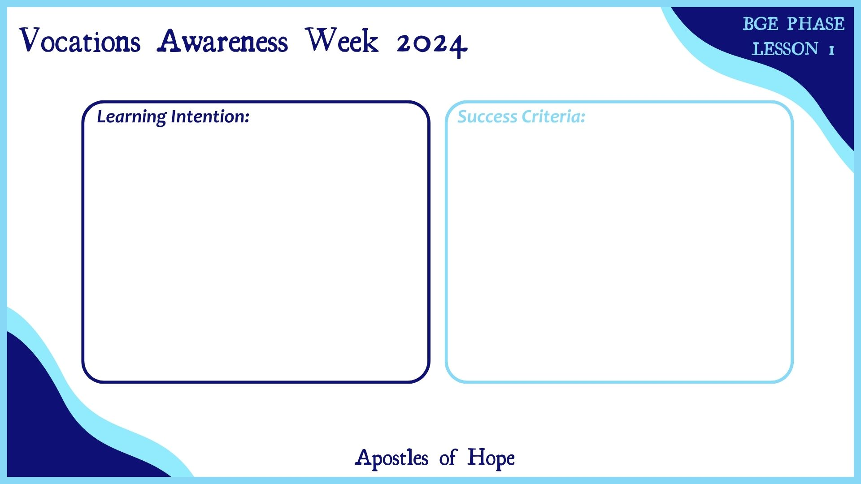
Notes:
Slide has been left blank so that schools can formulate their own LI’s and SC’s in line with their School/Authority policy.

Slide 3


Slide 4


Slide 5


Slide 6


Slide 7


Slide 8
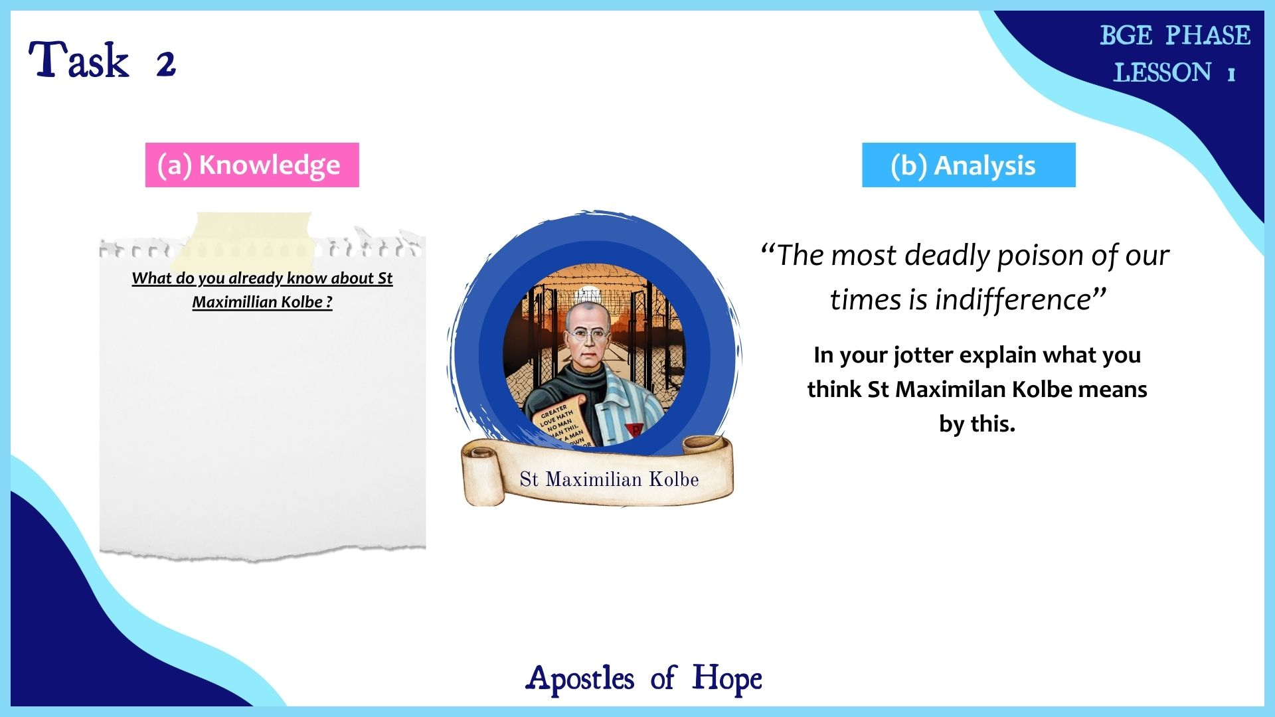

Slide 9


Slide 10


Slide 11


Slide 12


Slide 13


Slide 14
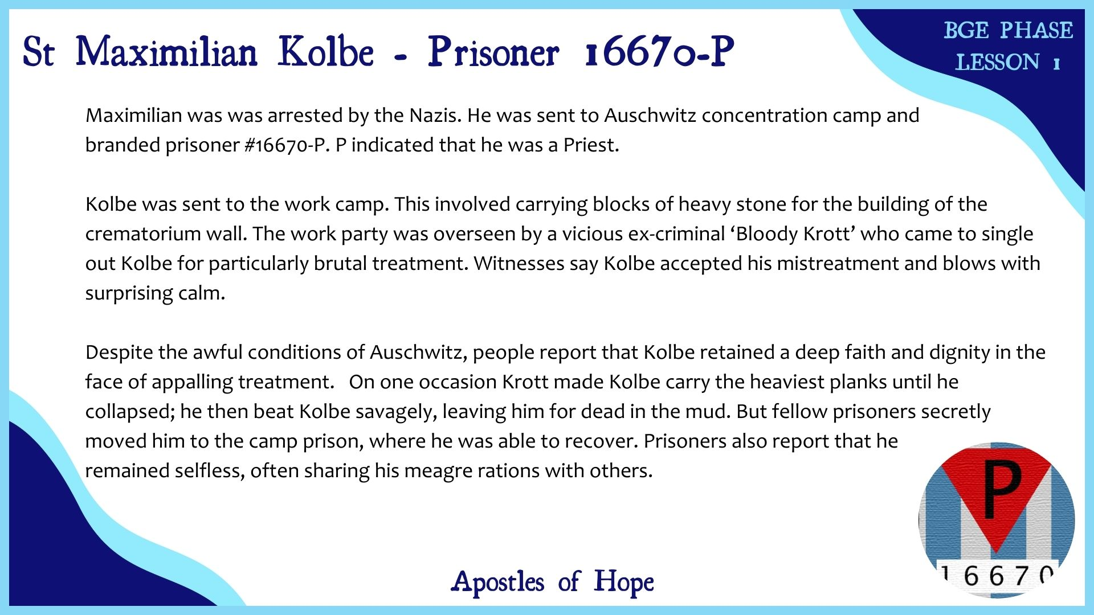

Slide 15
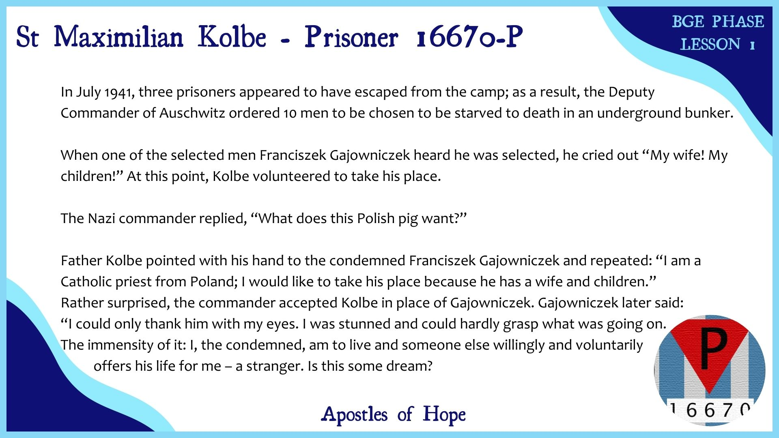

Slide 16
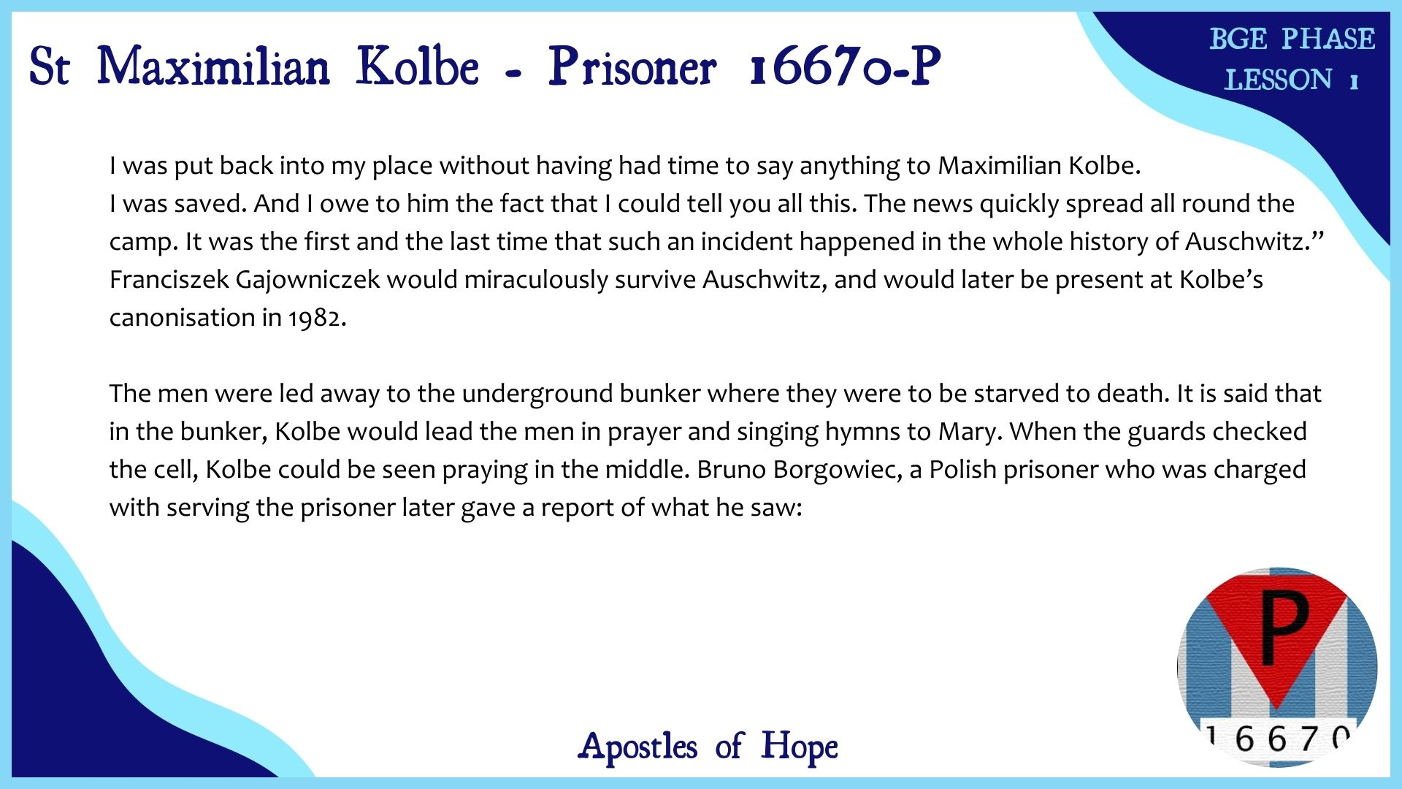

Slide 17
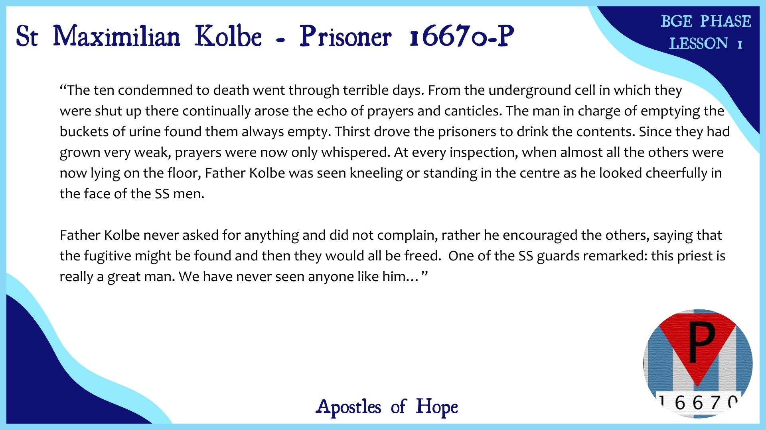

Slide 18
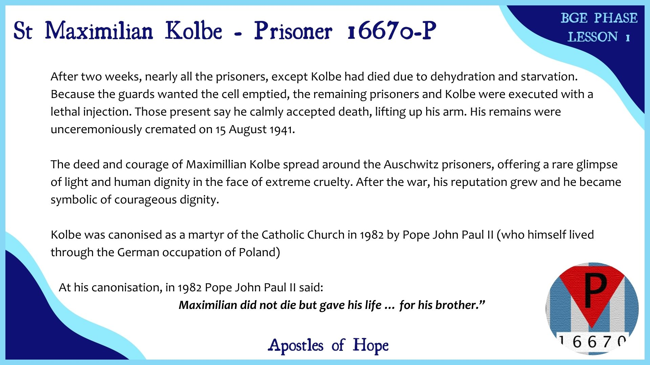

Slide 19
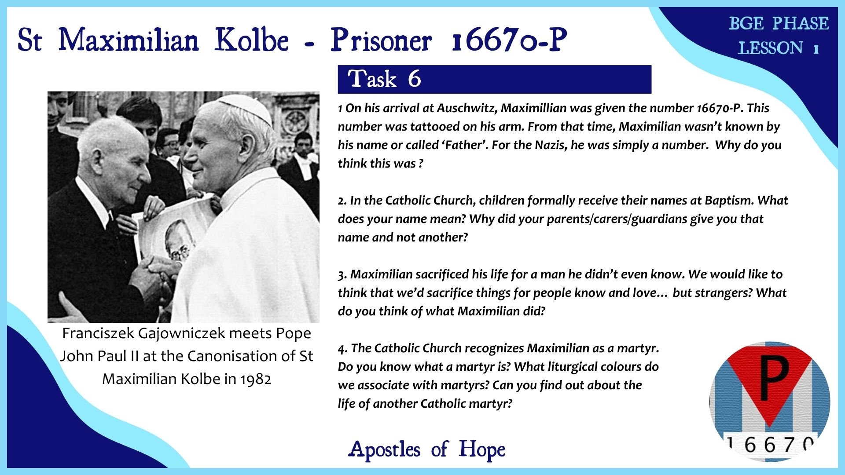

Slide 20


Slide 21


Slide 22


Slide 23
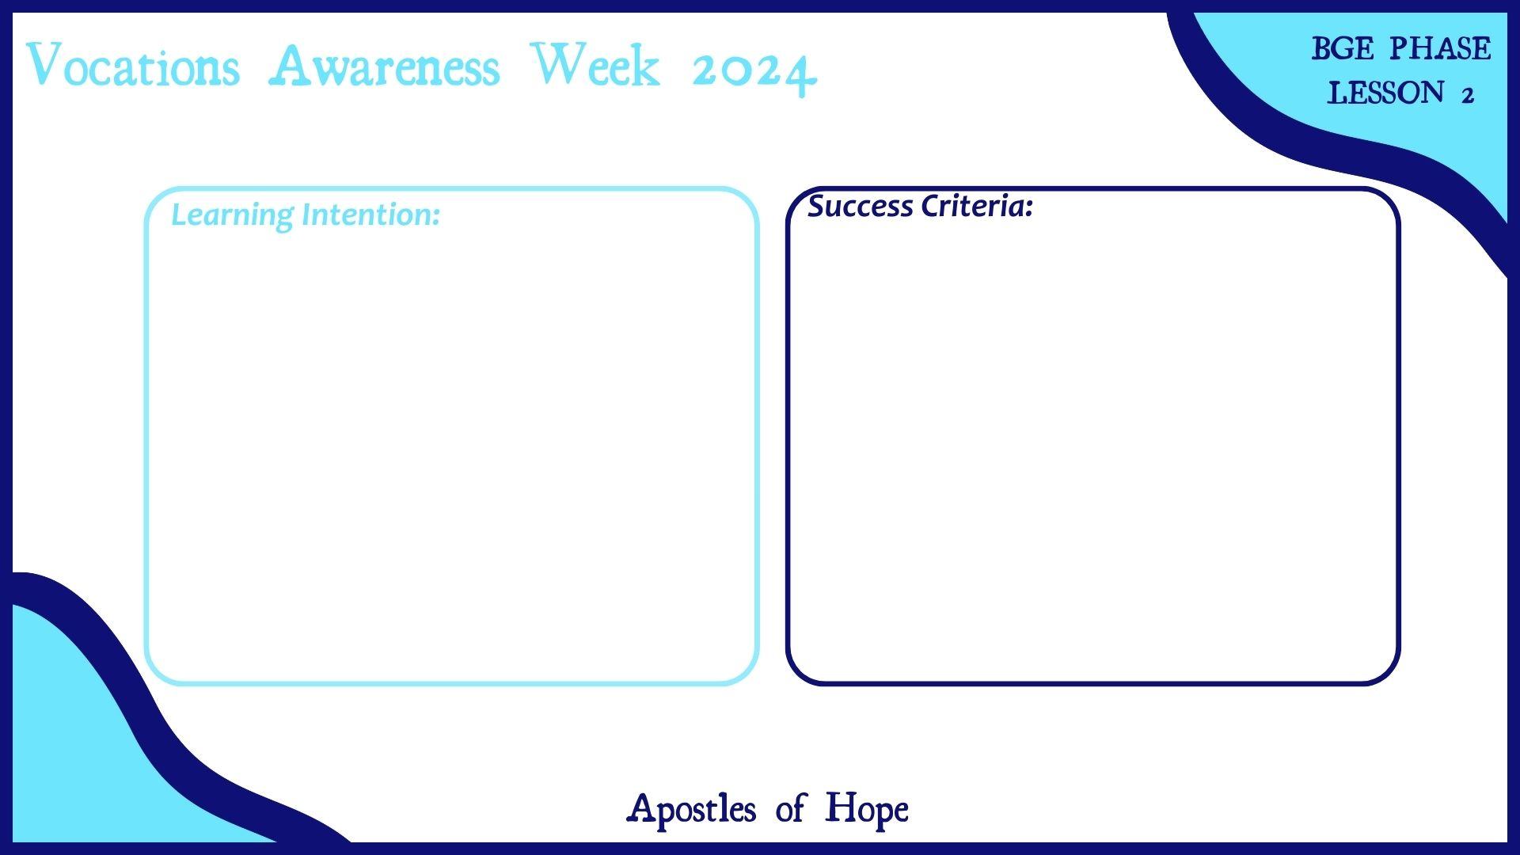
Notes:
Slide has been left blank so that schools can formulate their own LI’s and SC’s in line with their School/Authority policy.

Slide 24
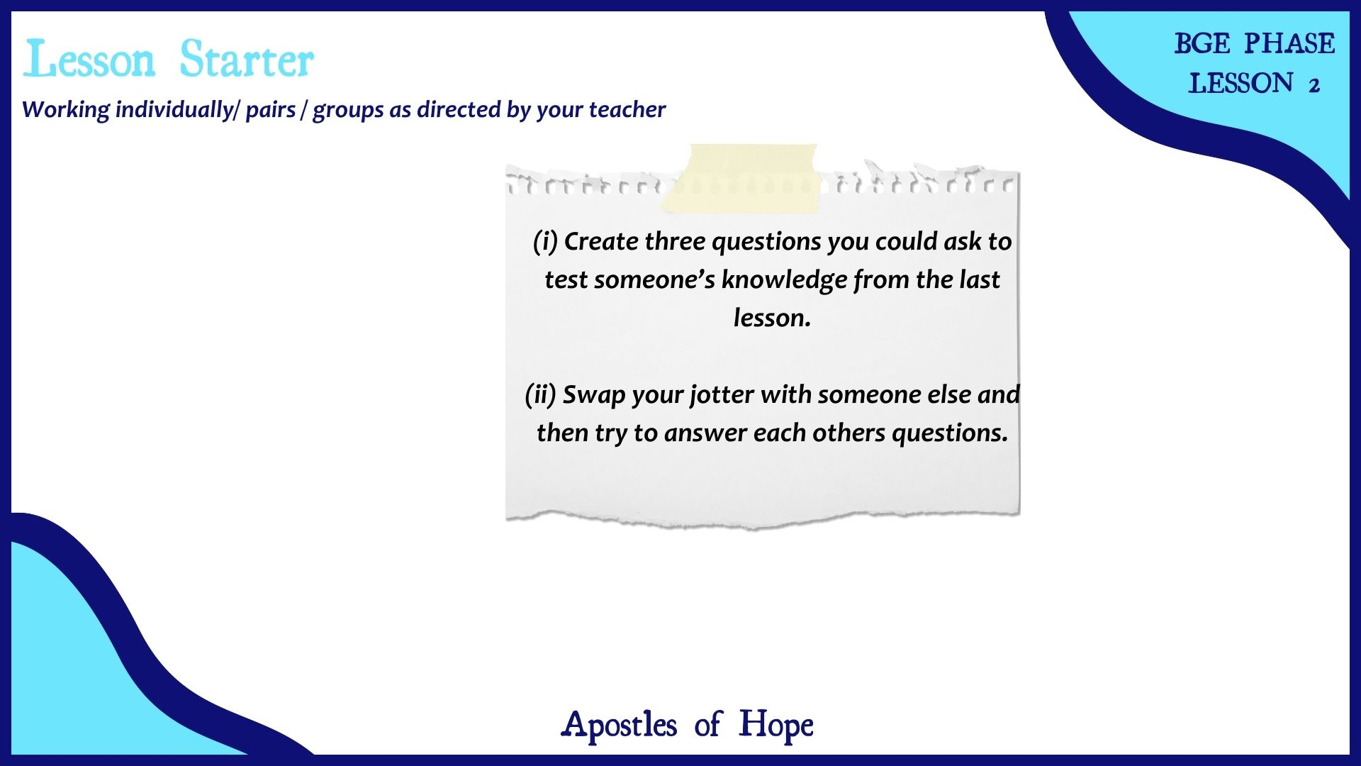

Slide 25


Slide 26


Slide 27


Slide 28


Slide 29
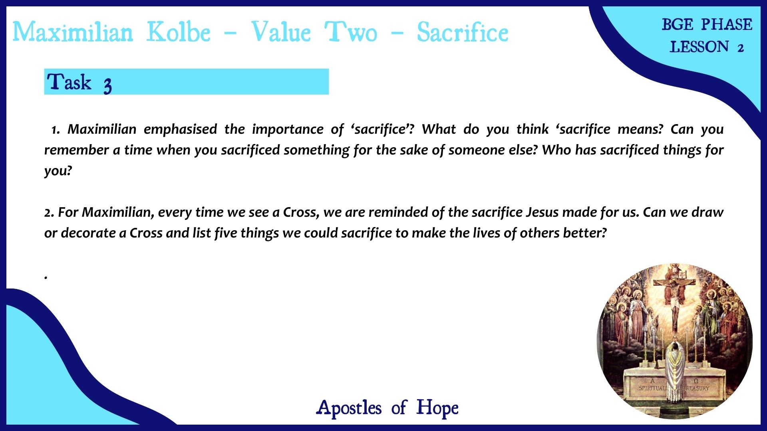

Slide 30


Slide 31


Slide 32
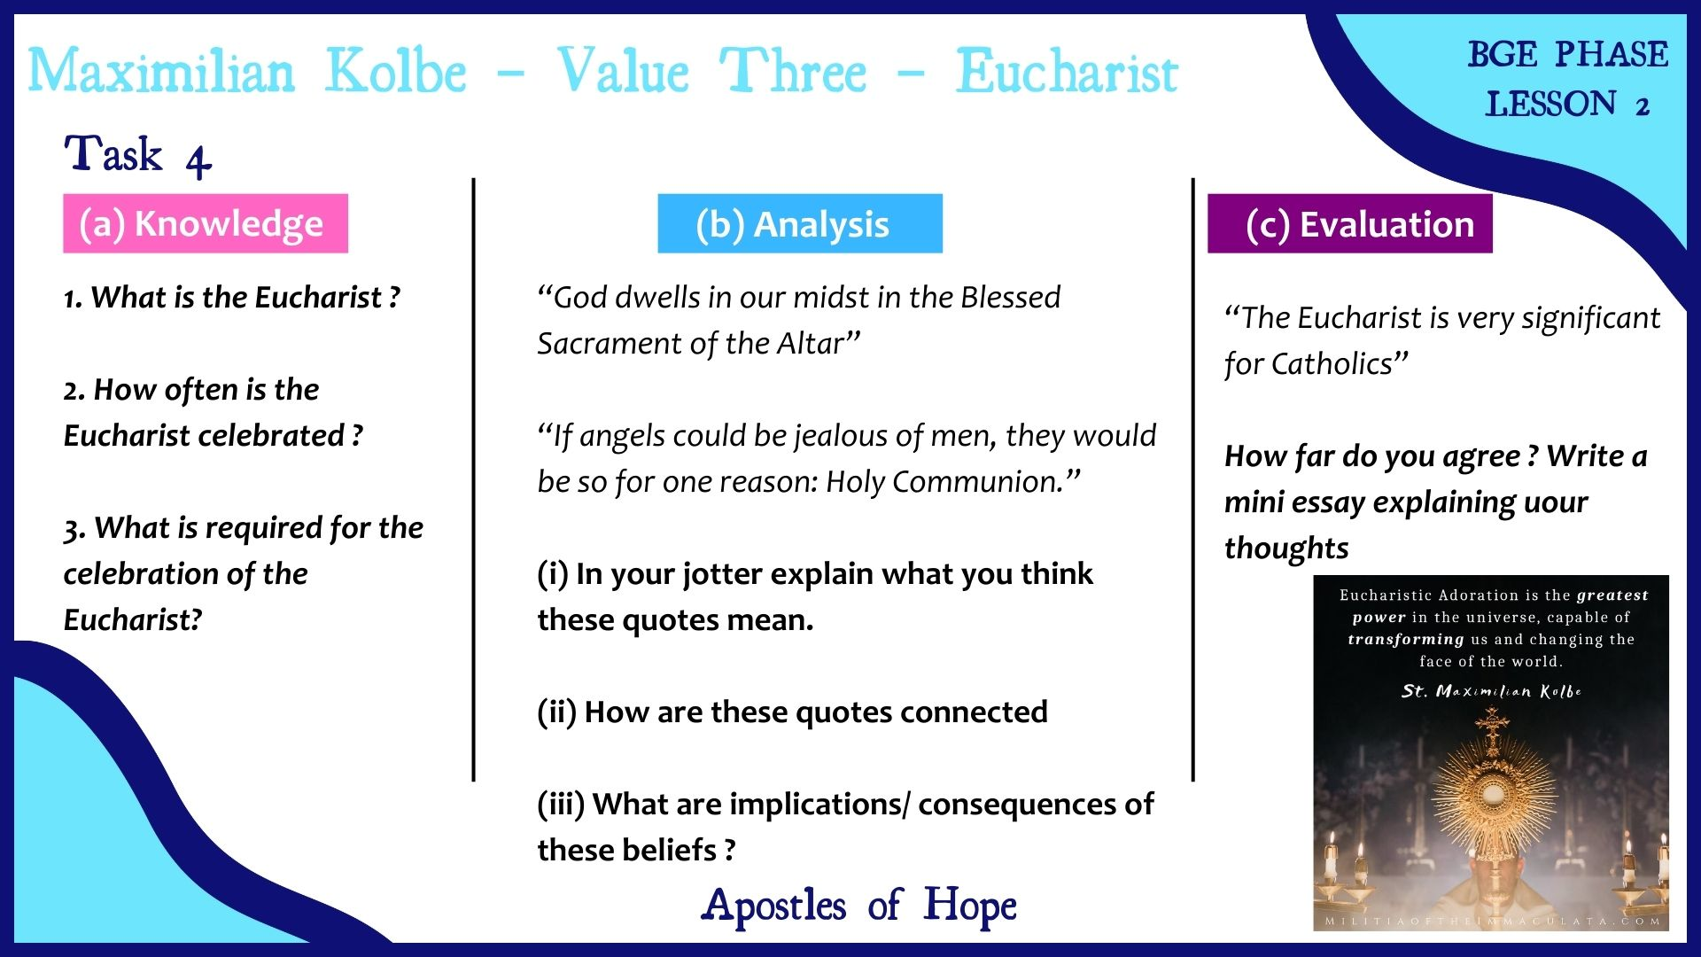

Slide 33


Slide 34
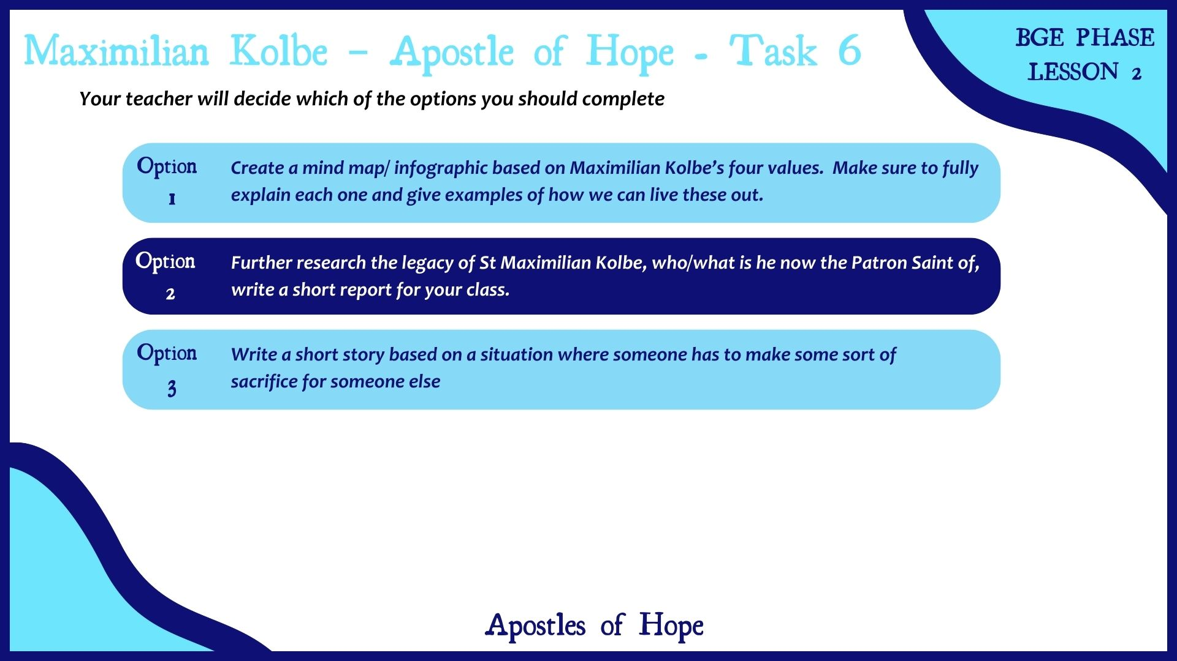

Slide 35


Slide 36


Slide 37


