Slide 1
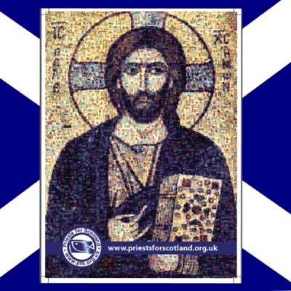
Vocations Awareness Week 2024
‘Apostles
of Hope’
Priests for Scotland

Slide 2

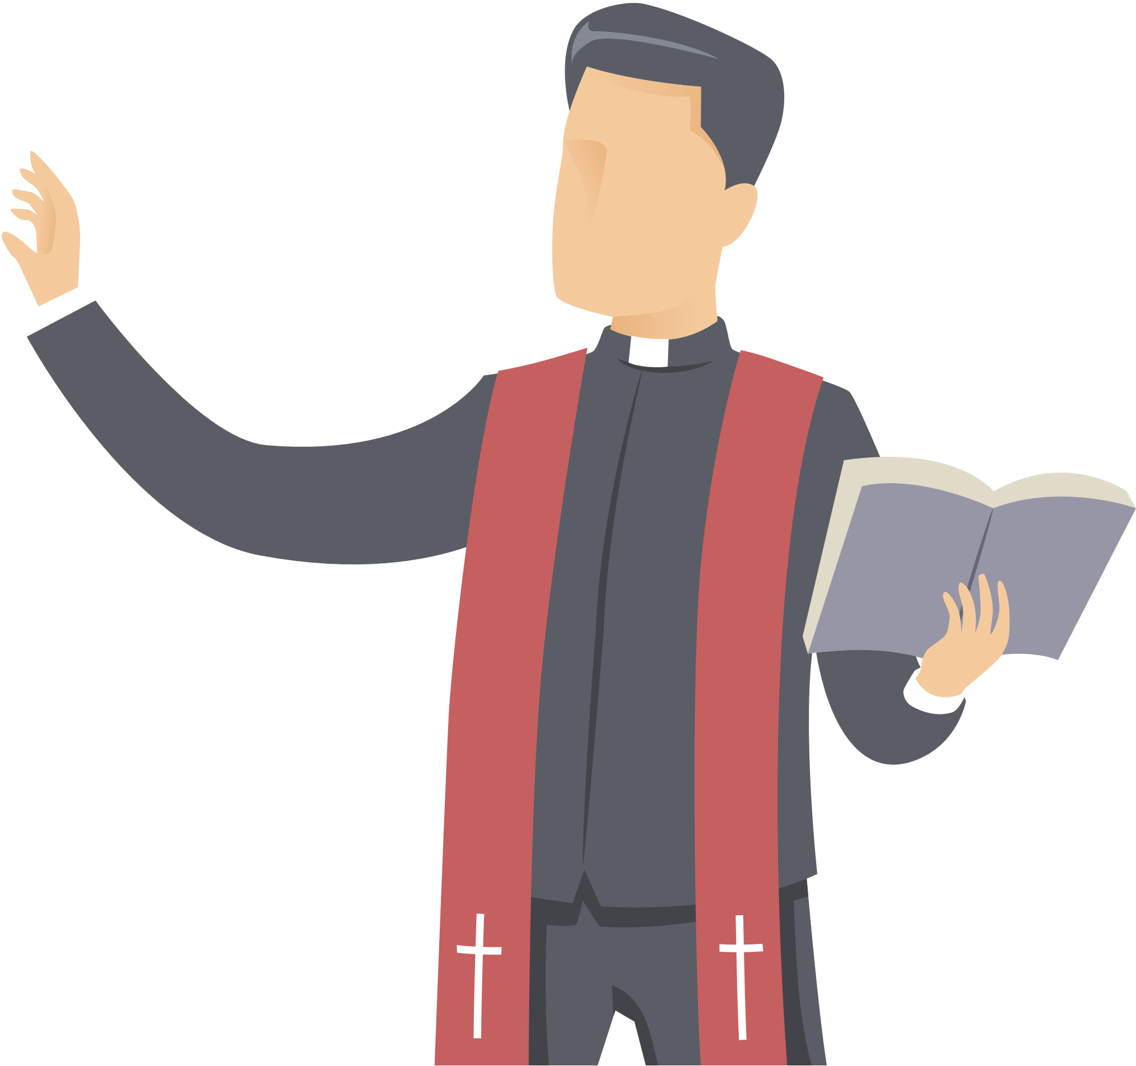

Vocations Awareness Week 2024
‘Apostles of Hope’
  A vocation is a call from God to serve Him.
  When we think about Vocations, we usually think about God calling Priests, Deacons and Religious Sisters in the Church.
  This isn’t, however, the whole story of how God calls people to serve Him. Through our Baptism, God calls us to serve him in our lives, in our families and in our schools.
  But how can we serve God?

Slide 3
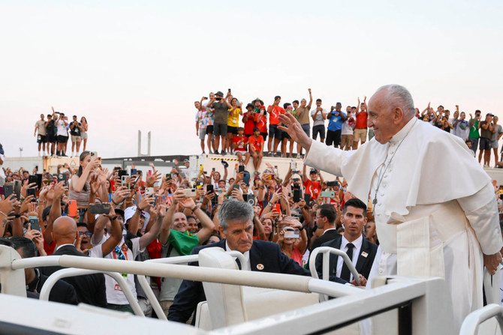
Vocations Awareness Week 2024
‘Apostles of Hope’
  In his most recent message on the theme of vocations, Pope Francis called on believers to be ‘Apostles of Hope’.
  This year, during Vocations Awareness of Week, we will be looking at the life of Saint Maximilian Kolbe, who through his life story continues to be an ‘apostle of hope’ in our time.

Slide 4
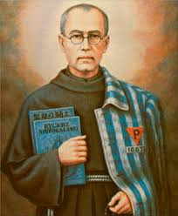
Vocations Awareness Week 2024
’
Maximilian Kolbe was born on 8 January 1894 in the Kingdom of Poland. At that time, Poland wasn’t an independent country but was part of Russian Empire.
From as long as he could remember, Maximilian had a very strong devotion, to the Virgin Mary. When he was still in primary school, he had a vision of the Virgin Mary.
She came to him holding two crowns, one white, the other red. She asked Maximilian if he would accept either of the crowns. The white one represented holiness, and the red meant becoming a martyr. Maximilian said that he would accept them both. At the age of 13, Maximilian left his home to go to another country to train to become a priest.
Maximilian Kolbe – A Life Less Ordinary

Slide 5
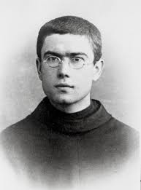
Vocations Awareness Week 2024
’
For Reflection/Discussion
Even as a child, Maximilian was very religious. Even while in. primary school. He would spend hours in prayer and attending Mass. What have been the most important events in your faith journey? What can you remember, for example, about your First Holy Communion?
Maximilian is a very popular name for children receiving the Sacrament of Confirmation. What Saint’s name will you choose at Confirmation?
Maximilian left home at 13 to train to become a Priest. Would this have been a difficult choice? What difficulties do you think Maximilian would have faced?
Maximilian Kolbe – A Life Less Ordinary

Slide 6
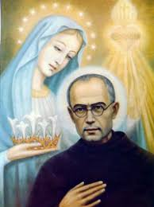
Vocations Awareness Week 2024
’
The Mission
After finishing his training, Maximilian left Europe to be a missionary in Japan. Before he travelled to Japan, he had to learn Japanese and he said he found this very difficult! In Japan he founded a monastery which continues to this day. The monastery was dedicated to Our Lady. Regrettably, he became ill and had to return to Poland.
For Reflection/Discussion
Maximilian left Europe to be a missionary in Japan., What do you think he would have found difficult in doing this?
Maximilian founded a monastery in Japan and named it after Mary. Again this indicates the place Mary held in his faith! What do you know about Mary? The Catholic faith dedicates several days to Mary throughout the year. Once of these days is called the ‘Assumption’ and was celebrated just over a month ago. Can you find out more about this day?
Maximilian Kolbe – A Life Less Ordinary

Slide 7
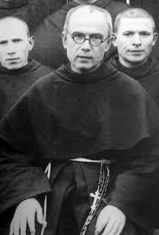
Vocations Awareness Week 2024
The Second World War
At the start of the Second World War, Kolbe was living in a monastery in the eastern part Poland. When Poland was overrun by the Nazi forces in 1939, he was arrested under general suspicion on 13 September but was released after three months.
When first arrested, he said:
“Courage, my sons. Don’t you see that we are leaving on a mission? Let us, then, tell the Blessed Virgin that we are content and that she can do with us anything she wishes”.
In 1941, his newspaper “The Knight of the Immaculate” Maximilian offered strong criticism of the Nazis. It is believed that after Maximilian wrote this, the Nazis decided to arrest him and send him to a concentration camp.
Maximilian Kolbe – A Life Less Ordinary

Slide 8
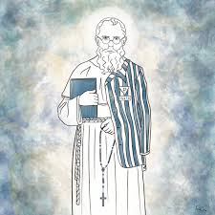
Vocations Awareness Week 2024
For Reflection/Discussion
When they first occupied Poland, the Nazis arrested many priests. Priests were non-combatants – they weren’t allowed to fight. So why do you think the Nazis targeted them?
Throughout the Nazi occupation, Maximilian showed an enormous amount of courage. What do you think courage is? Do you think priests need to be courageous? If so, how?
Maximilian Kolbe – A Life Less Ordinary

Slide 9

Vocations Awareness Week 2024
Prisoner 16670
Maximilian was was arrested by the Nazis. He was sent to Auschwitz concentration camp and branded prisoner #16670-P. P indicated that he was a Priest.
Kolbe was sent to the work camp. This involved carrying blocks of heavy stone for the building of the crematorium wall. The work party was overseen by a vicious ex-criminal ‘Bloody Krott’ who came to single out Kolbe for particularly brutal treatment.
Witnesses say Kolbe accepted his mistreatment and blows with surprising calm.
Despite the awful conditions of Auschwitz, people report that Kolbe retained a deep faith and dignity in the face of appalling treatment.
Maximilian Kolbe – A Life Less Ordinary

Slide 10
Vocations Awareness Week 2024
The Sacrifice
In July 1941, three prisoners escaped from the camp. As a result, the Deputy Commander of Auschwitz ordered 10 men to be executed.
When one of the selected men Franciszek Gajowniczek heard he was selected, he cried out “My wife! My children!” At this point, Kolbe volunteered to take his place.
Gajowniczek later said:
“I could only thank him with my eyes. I was stunned and could hardly grasp what was going on. The immensity of it: I, the condemned, am to live and someone else willingly and voluntarily offers his life for me – a stranger. Is this some dream?
I was put back into my place without having had time to say anything to Maximilian Kolbe. I was saved. It was the first and the last time that such an incident happened in the whole history of Auschwitz.”
Maximilian Kolbe – A Life Less Ordinary

Slide 11
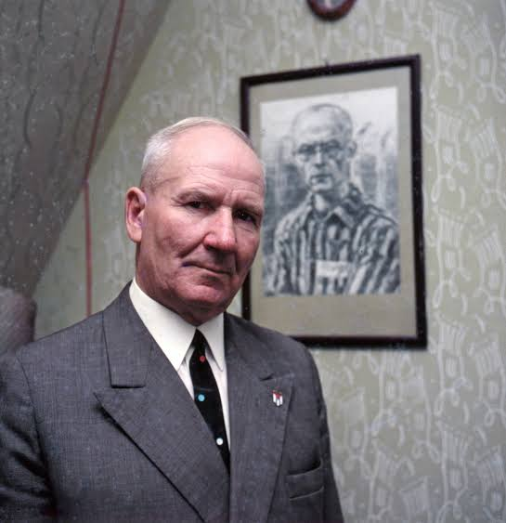
Vocations Awareness Week 2024
The Legacy
The story of Maximillian’s sacrifice spread quickly around the Auschwitz prisoners. After the war, his reputation grew and he became a symbol of courage.
Franciszek became a missionary and dedicated his life to sharing the story of how he had been saved by Maximilian Kolbe. He said that as ‘long as I have breath in my lungs, it will be my duty to tell the story of the sacrifice Maximilian made for me”
Kolbe was recognised as a Saint of the Catholic Church by Pope John Paul II in 1981.
Pope John Paul II said of him:
“Maximilian did not die but gave his life … for his brother”
Franciszek Gaiowniczek beside a picture of Maximilian Kolbe

Slide 12
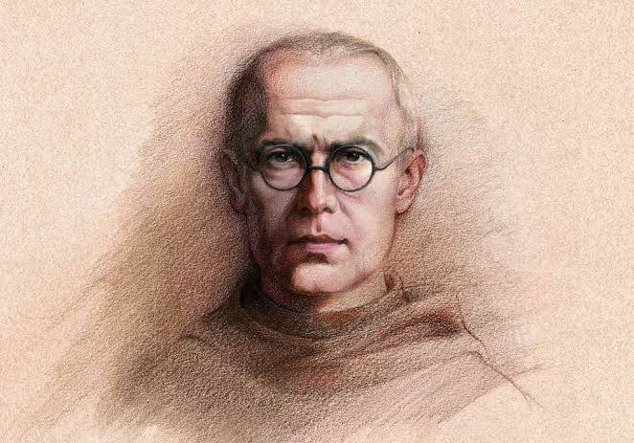
Vocations Awareness Week 2024
Your teacher will decide which of the options you should complete:
1. Imagine that you are Franciszek Gajowniczek. Write a diary extract for the day St. Maximillian swapped places with you. You should include, everything that has happened today, how it made you feel and what you think might happen in the future.
2. Imagine that you are interviewing Maximilian Kolbe or Franciszek Gajowniczek or both. Write a script of the questions you would ask them and also the answers they would give.
3. Create your own story board/carton strip in which you illustrate the events of the life of Maximilian Kolbe.

Slide 13
Vocations Awareness Week 2024
Prayer
Lord Jesus, you said that ‘no one has greater love than this, to lay down one’s life for one’s friends’.
We pray that through the intercession of St. Maximilian Kolbe that we, too, may give ourselves entirely without reserve to you in the love and service of each other.
Amen

Slide 14
Vocations Awareness Week 2024
In our last lesson, we looked at the life of Saint Maximilian Kolbe and his martyrdom at Auschwitz.
Maximilian is best known as a priest and martyr in the Catholic Church, but he was also a prolific writer! For many years, he worked as a journalist in the Catholic press in Poland. His writings help us understand the values that shaped his life.
Most schools in Scotland also have a set of school values—qualities they aim to encourage and principles according to which the school is run.
For Reflection/Discussion
What were the values of your primary school?
Can you give an example of how you put these into action?
What are the values of the school you’re presently attending,. How might you put these into practice today?
Lesson Two

Slide 15
Vocations Awareness Week 2024
Maximilian Kolbe – Value One – ‘Model Mary’
Looking at many writings, it's easy to notice just how important Mary, the Mother of Jesus, was in Maximilian’s life.
In a way, this isn’t surprising; Mary has a very important position in the Catholic faith.
In every Catholic Church, anywhere in the world, you’ll always find an image of Mary - be it a painting or a statue. What’s more, one of the few prayers all Catholics know is the Hail Mary and, surely, one of the few possessions all Catholics have is a set of rosary beads. Catholics have a very special connection with Mary!
Yet, as Maximilian would point out, we must never lose sight of what makes Mary really special and that lies her being a model of how to live out the Christian faith.
Lesson Two

Slide 16
Vocations Awareness Week 2024
Maximilian Kolbe – Value One – ‘Model Mary’
When the Archangel Gabriel, appeared to her and asked her to be the mother of Jesus, Mary said ‘yes; without doubt or condition or charge! Mary fully accepted God’s plan for her life and Maximilian would suggest that we try and do the same!
For Reflection/Discussion
Are you aware that God has a plan for your life? Are you aware He wants you to be part of the project of building His kingdom here on earth – a kingdom founded on values of humility, compassion, kindness, justice, forgiveness, integrity, peace and courage?
Catholics believe we find God’s plan for our lives by spending time in prayer. Do you ever spend time in prayer? Can you write a prayer asking God to make you aware of his plan for your life?
Lesson Two

Slide 17
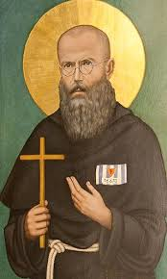
Vocations Awareness Week 2024
Maximilan Kolbe – Value Two – ‘Sacrifice’
In his writings, Maximilian speaks again and again about the importance of Sacrifice in the Catholic faith. Jesus sacrificed His life for us on the Cross and we’re challenged to imitate his example by sacrificing things in our lives for the good of others.
Maximilian was, of course, to give an example of this when he sacrificed his own life for a stranger in Auschwitz.
As we begin our year in school what could we sacrifice to make our lives, the lives of others and the life of our school better?
Perhaps we could ‘sacrifice’ our time by getting to Mass especially on Sundays?
Perhaps we could ‘sacrifice’ patterns of behaviour which make our lives and the lives of others difficult?
Perhaps we could sacrifice some money to help those who are less fortunate than ourselves?
Lesson Two

Slide 18
Vocations Awareness Week 2024
Maximilian Kolbe – Value Two – ‘Sacrifice’
Maximillian emphasised the importance of ‘sacrifice’? What do you think ‘sacrifice means? Can you remember a time when you sacrificed something for the sake of someone else? Who has sacrificed things for you?
For Maximilian, every time we see a Cross, we are reminded of the sacrifice Jesus made for us. Can we draw or decorate a Cross and list five things we could sacrifice to make the lives of others better?
Lesson Two

Slide 19
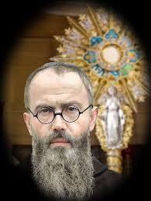
Vocations Awareness Week 2024
Maximilian Kolbe – Value Three – ‘Eucharist’
Another very common theme in the writings of Maximilian was the importance of the Eucharist in the Catholic faith. For Maximilian, the Eucharist, Holy Communion is the food that nourishes and sustains our journey of faith. Without the Eucharist and Mass, the journey of faith can become very, very challenging. Holy Communion is food for the journey of faith!
Indeed, Maximilian famously said, “If angels could be jealous of men, they would be so for one reason: Holy Communion.”
During his time in Auschwitz, despite all the difficulties, Maximilian managed to celebrate Mass for his fellow prisoners – giving them comfort and consolation.
By celebrating Mass and the other Sacraments in the Camp, Maximilian was certainly proved to be an Apostle of Hope!
Lesson Two

Slide 20
Vocations Awareness Week 2024
Maximilan Kolbe – Value Three – ‘Eucharist’
What role does faith play in your life? Does it influence the way you behave?
Maximilian famously said, “If angels could be jealous of men, they would be so for one reason: Holy Communion.” Can you explain what this quote means?
Lesson Two

Slide 21
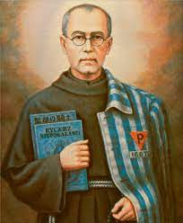
Vocations Awareness Week 2024
Maximilian Kolbe – Value Four – ‘Passion’
Maximilian threw himself into everything he did; he always gave 100%. Whether it was a missionary, writing newspaper articles or standing up to the Nazis, he never stopped! Maximilian, in his writings, frequently wrote that a huge problem in the world is that people rarely stand up and make a difference.
For Maximilian, it was important to do things with passion, courage and determination.
Maximilian famously reflected: “Do not forget that serving God doesn’t consist in doing extraordinary things, but doing the ordinary things in life with extraordinary passion, love and commitment”.
Lesson Two

Slide 22
Vocations Awareness Week 2024
Maximilan Kolbe – Value Four – ‘Passion’
What would you like to change in your community, your school, and the world?
Pope Francis has regularly challenged Catholics to work on three issues: climate change, poverty and reaching out to people who are often forgotten and overlooked – the homeless, the elderly and the sick. How can you help them? What can your school do?
Lesson Two

Slide 23
Vocations Awareness Week 2024
Maximilian Kolbe – Value Four – ‘Passion’
Your teacher will as you to complete one of the following tasks:
Create a mindmap or infographic based on Maximilian’s four values. Make sure to fully explain each one and explain how we can live these out.
Further research the legacy of Maximilian Kolbe. Can you find our anything more about him? Write a short report for your class.
Write a short story based on a situation where someone has to make some sacrifice for someone else.
Lesson Two

Slide 24
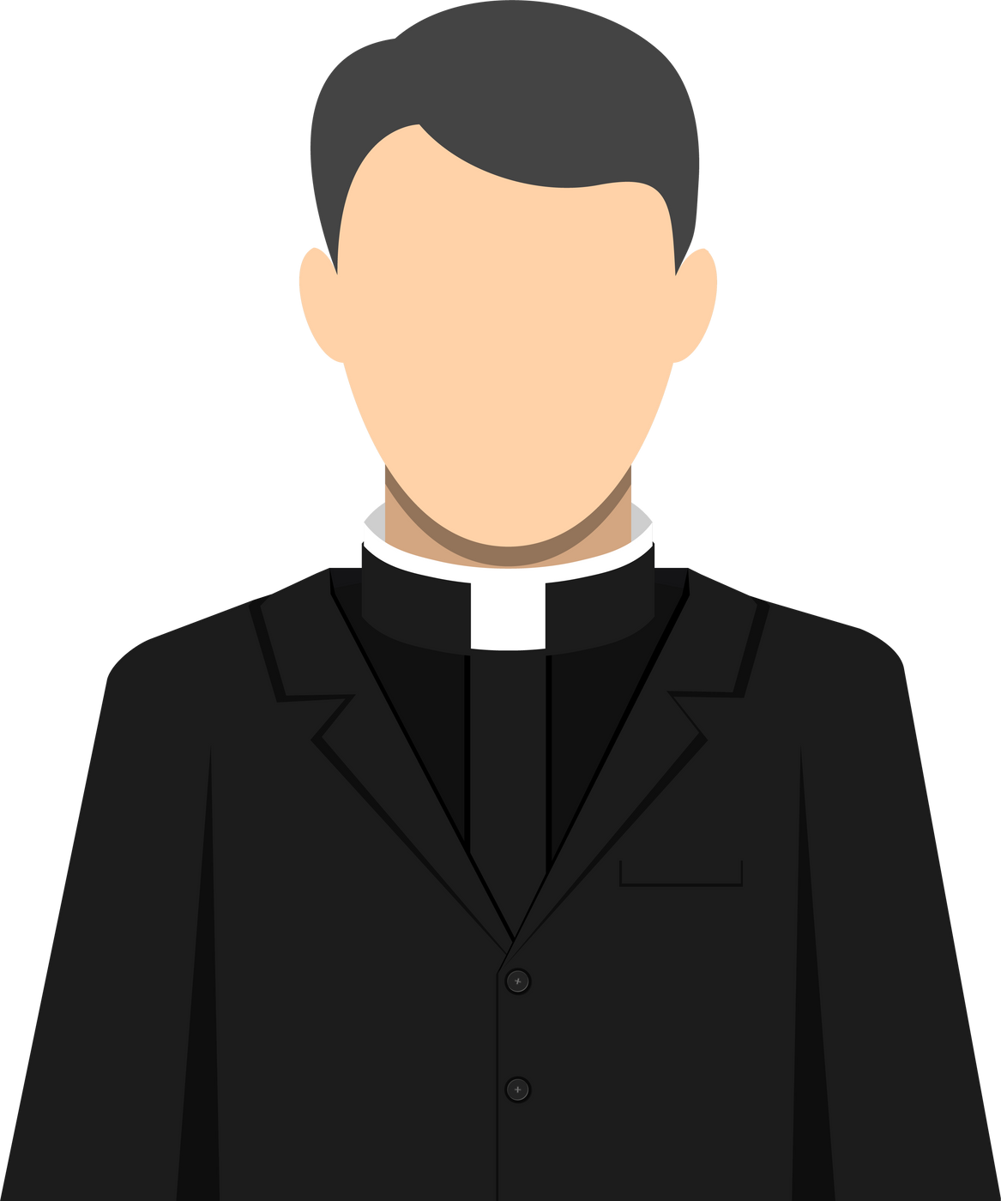
Vocations Awareness Week 2023
Apostles of Hope
  Priests are called by God to be like Maximilian Kolbe, to be ‘Apostles of Hope’ in their local communities by being kind, compassionate and supportive.
  What kind of qualities and talents do you think they should have?
  Do you know a priest, deacon, or religious sister? What are their qualities and talents?

Slide 25

Vocations Awareness Week 2023
Prayer
Dear God, thank you for giving us the gift of the life of Saint Maximilian Kolbe. May we imitate in our lives the values that were so important to him. May many people be inspired to follow his example and serve you in the Priesthood and the religious life. Amen!
Apostles of Hope

